Slide 1

LECTURE-4
BT101-Introductory Biology
Dr. Kusum K. Singh
Department of Biosciences and Bioengineering
Indian Institute of Technology Guwahati

Slide 2
2’-Deoxyribose Nucleic Acid
Contents:
B-DNA characteristics.

Slide 3
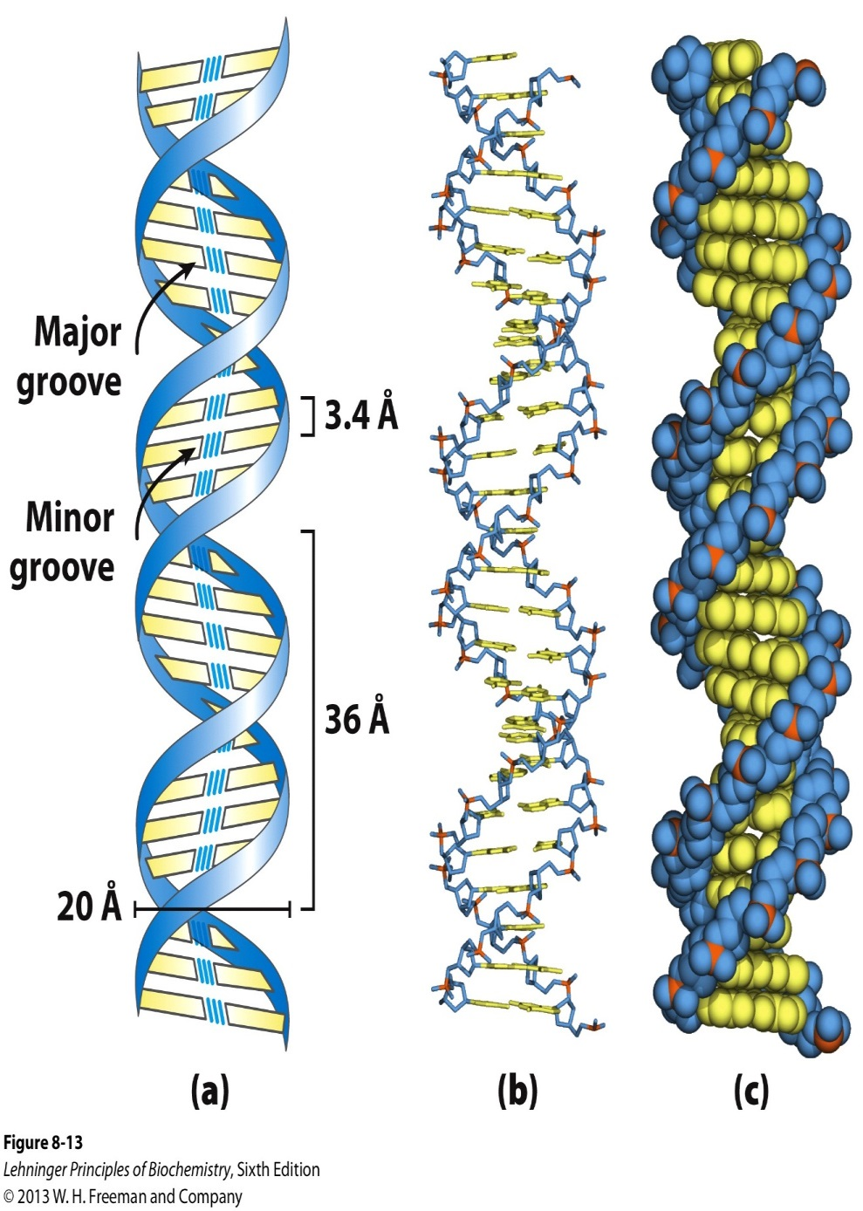
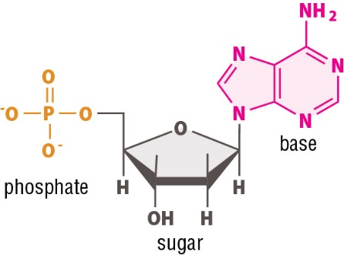
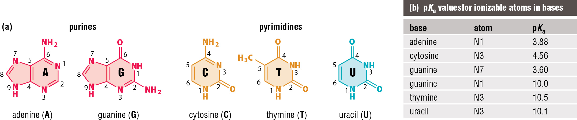
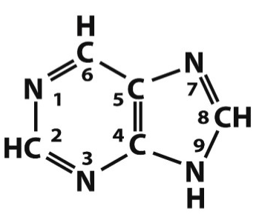

Watson-Crick Model of B-DNA
Nucleotide =
Nitrogenous base
Pentose sugar
Phosphate
Nucleoside =
Nitrogenous base
Pentose sugar
Notes:
LEGEND 8.13

Slide 4
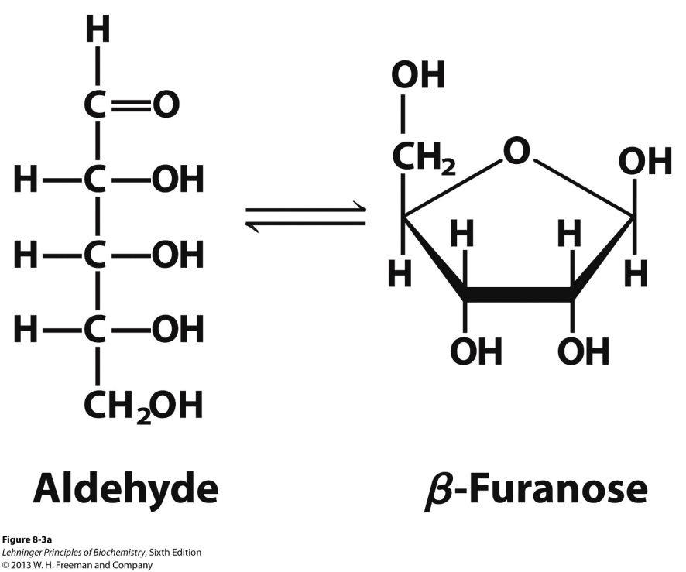
Watson-Crick Model of B-DNA
Pentose Sugar
Notes:
LEGEND 8.13

Slide 5
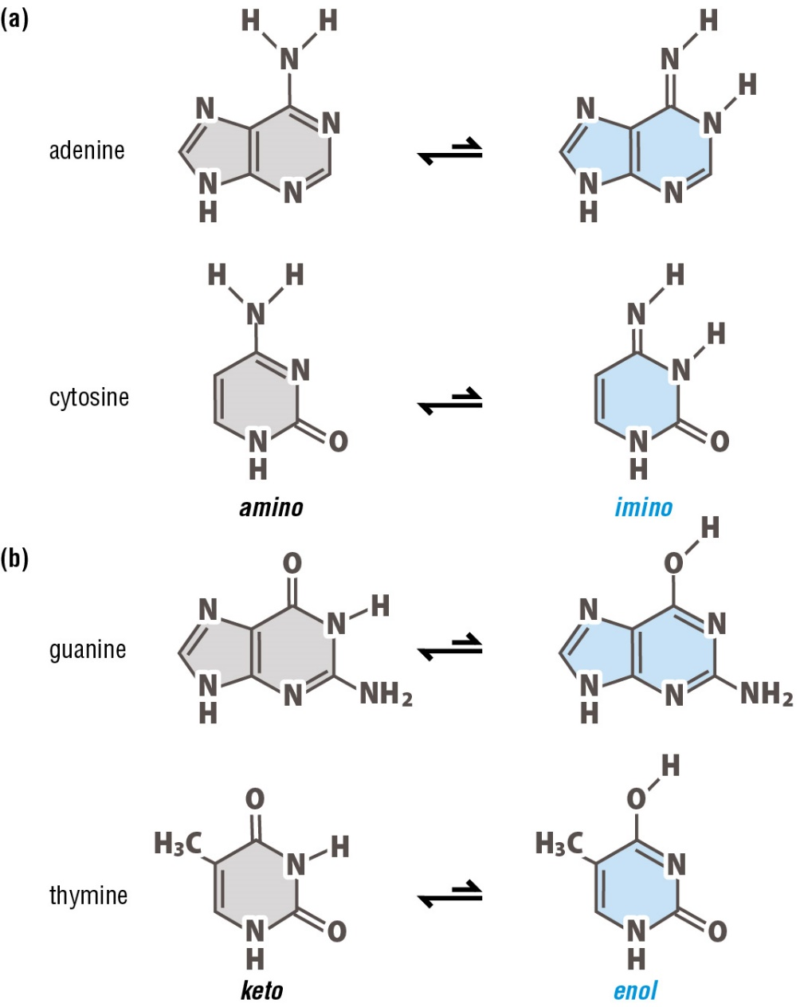
Watson-Crick Model of B-DNA
Nitrogenous base
Notes:
LEGEND 8.13

Slide 6
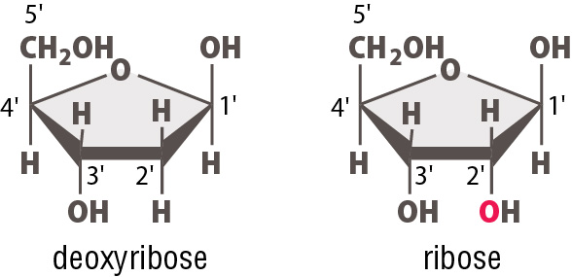
Watson-Crick Model of B-DNA
Pentose Sugar
Notes:
LEGEND 8.13

Slide 7
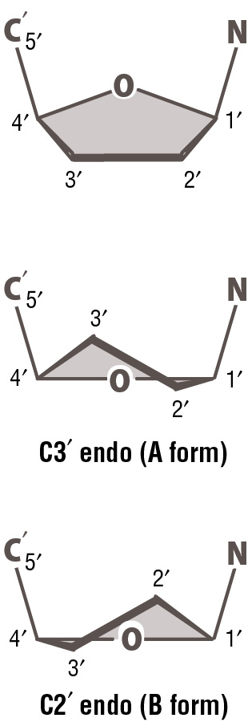
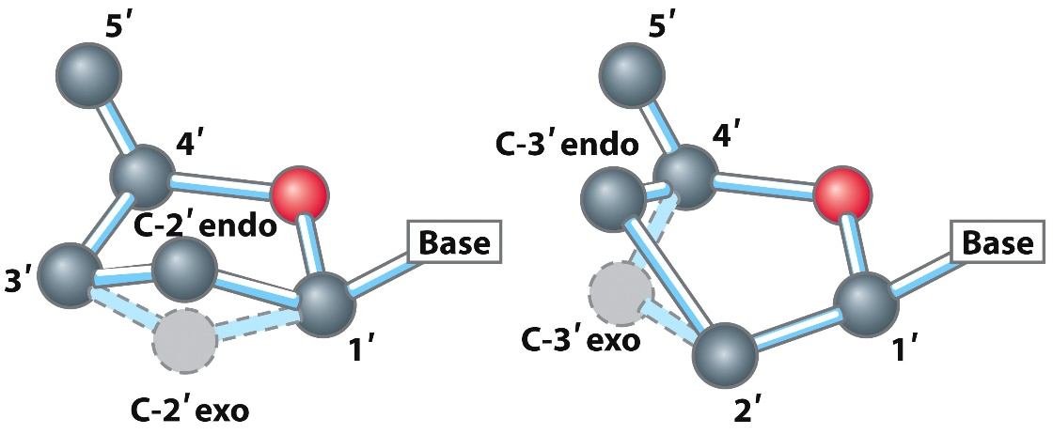
Watson-Crick Model of B-DNA
Pentose Sugar
Notes:
LEGEND 8.13

Slide 8
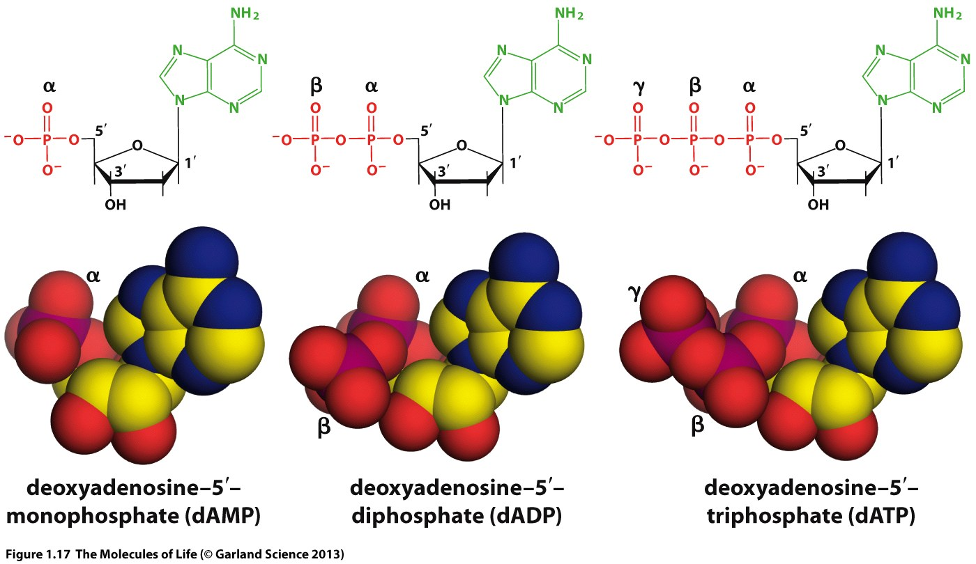
Watson-Crick Model of B-DNA
Phosphate
Notes:
LEGEND 8.13

Slide 9
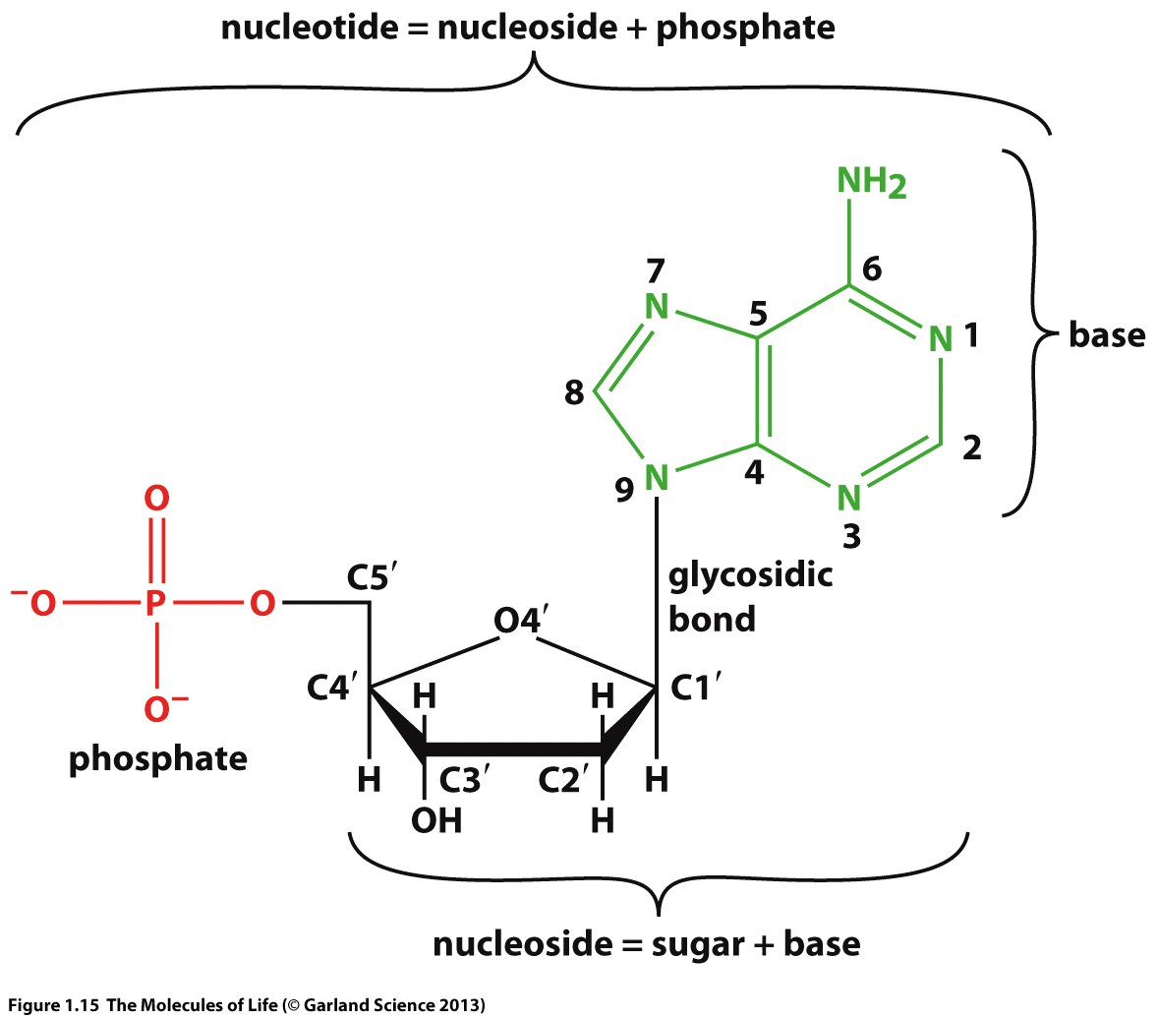
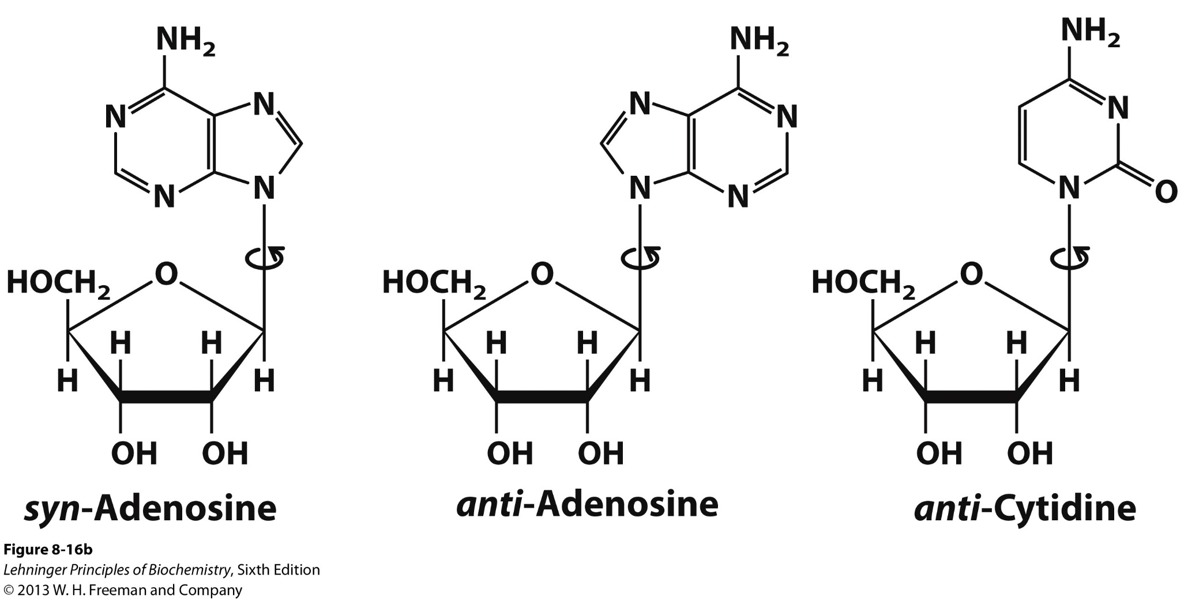
Watson-Crick Model of B-DNA
What we have seen so far….
Notes:
LEGEND 8.13

Slide 10
Watson-Crick Model of B-DNA
β-N-Glycosidic bond
Notes:
LEGEND 8.16B

Slide 11
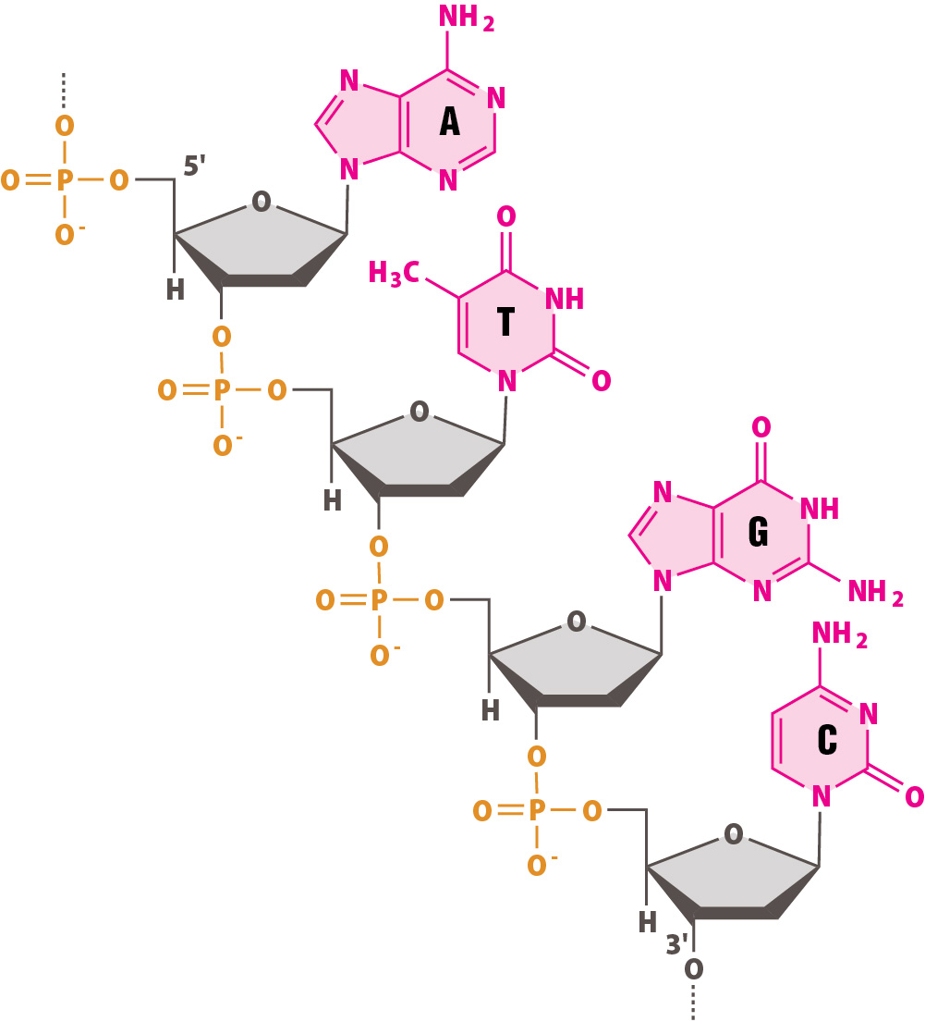
Watson-Crick Model of B-DNA
Polymers of nucleotides = polynucleotides
Notes:
LEGEND 8.16B

Slide 12
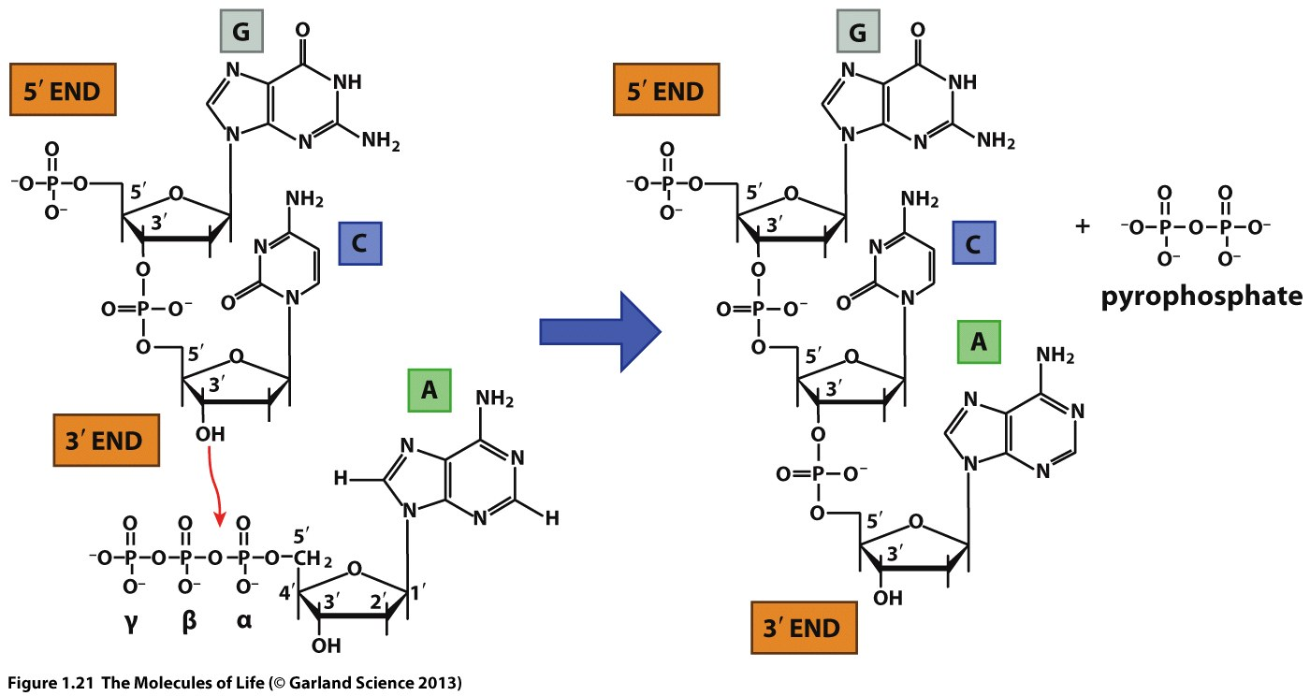
Formation of Polynucleotides

Slide 13
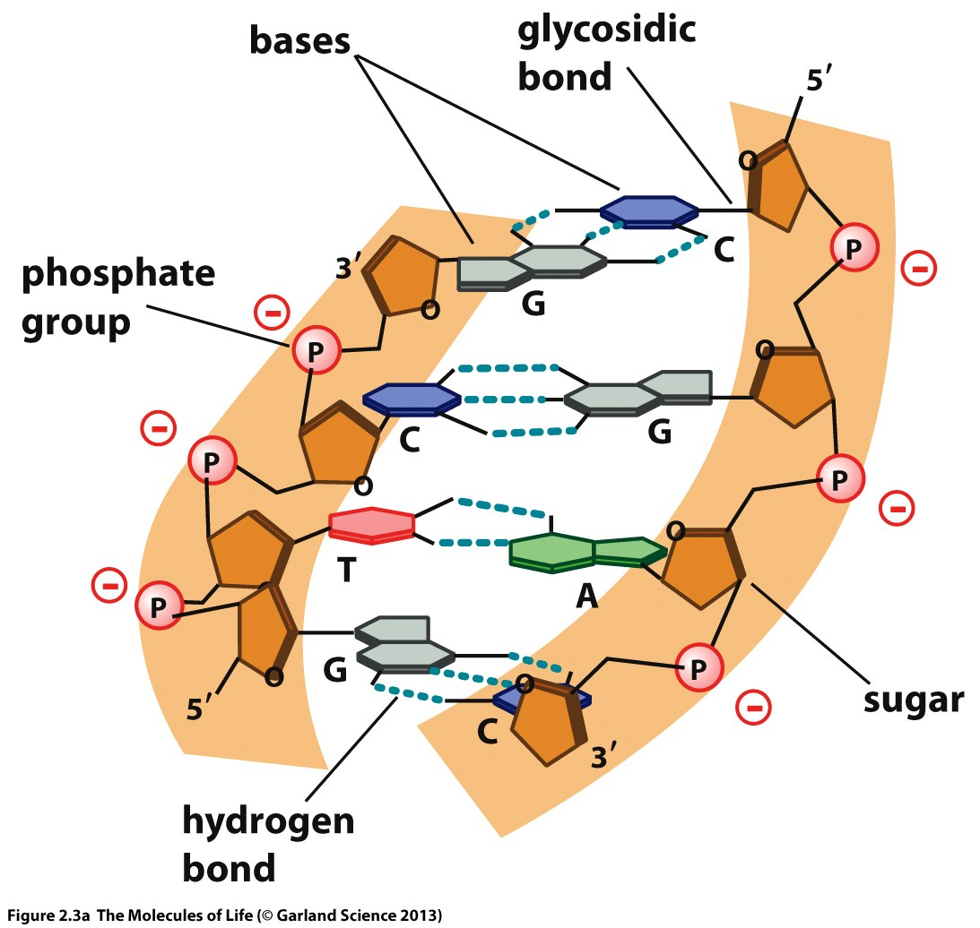
Double helical structure

Slide 14
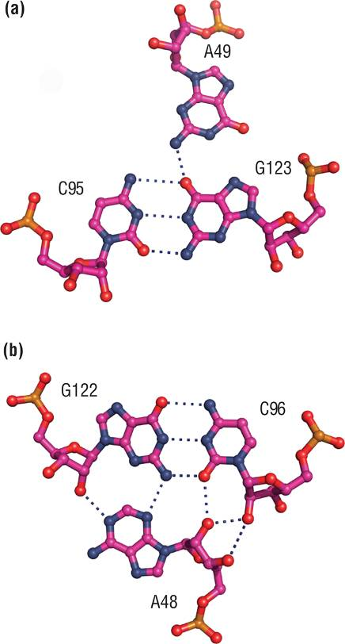
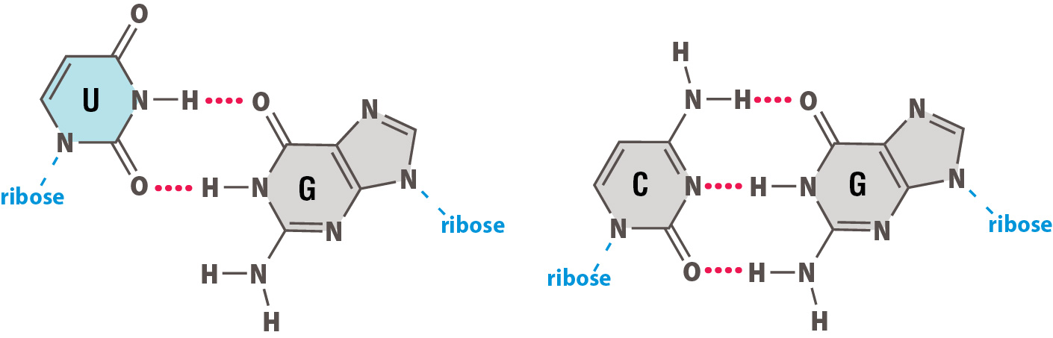
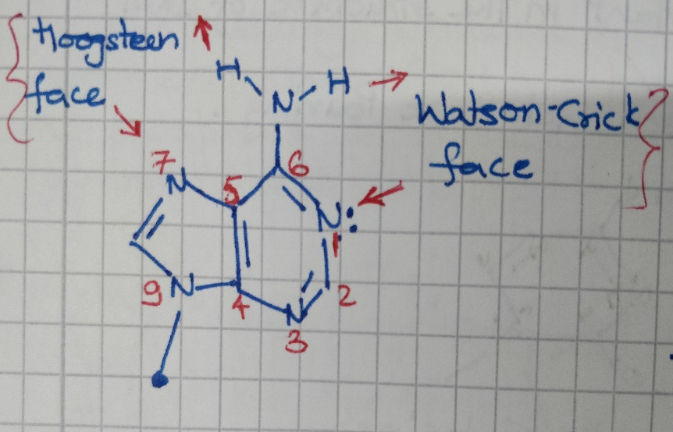
Watson and Crick base pairing
Wobble U-G pair
Watson-Crick C-G pair

Slide 15
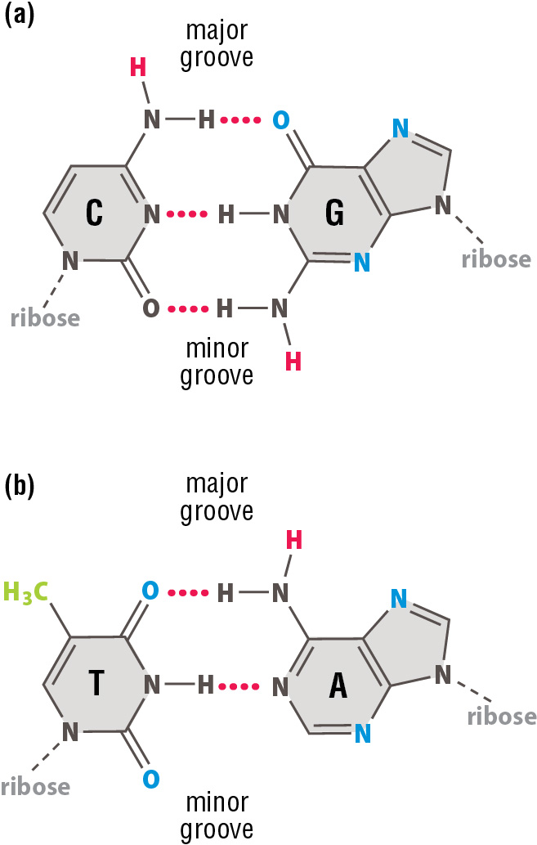
Major and Minor grooves

Slide 16
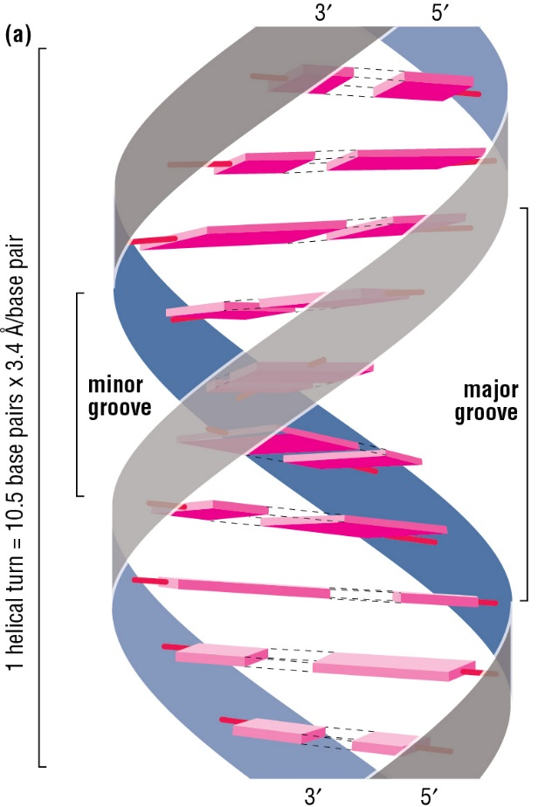


Various forces = DNA stability
Energetically favorable = formation of ds DNA = wind around one another in a right-handed helix
The hydrophobic bases = center, = away from the aqueous cellular environment
The hydrophilic sugar phosphate = backbone interacts favorably with water
Base pairs = stack interior, Van der Waals interactions = bases stabilize the interactions
“base-stacking”= energetically favorable, = stability of DNA

Slide 17

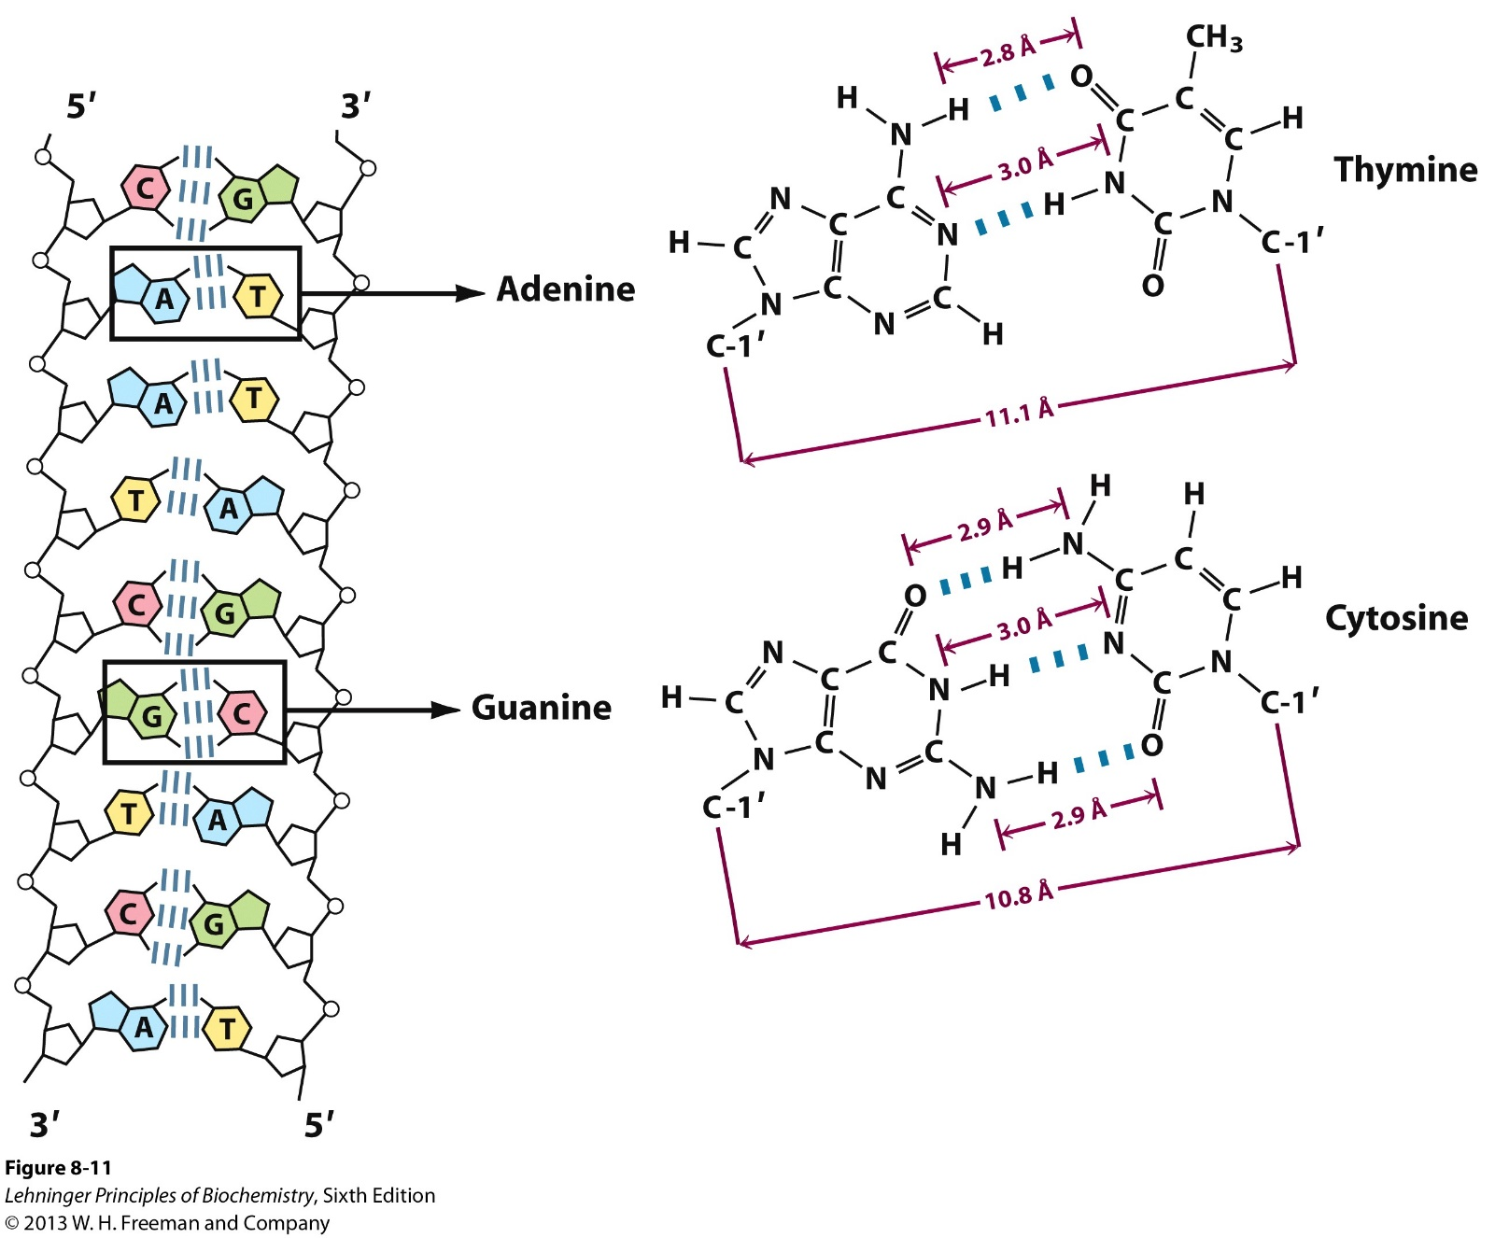
Watson-Crick Model of B-DNA
A-T and G-C base pairs have similar widths, so the helix diameter is ~20 Å
Notes:
LEGEND 8.13

Slide 18

Watson-Crick Model of B-DNA
A-T and G-C base pairs have similar widths, so the helix diameter is ~20 Å
B-DNA = predominant configuration. The helix repeats every 10.5 base pairs, and base pairs are 3.4 Å apart
In B-DNA, the helix forms a major groove (~13 Å) and a minor groove (~9 Å)
The shape and size of these grooves govern interactions with other molecules
The sequence of bases in DNA can influence structure: regions rich in A-T pairing tend to be more bendable
Notes:
LEGEND 8.13

Slide 19
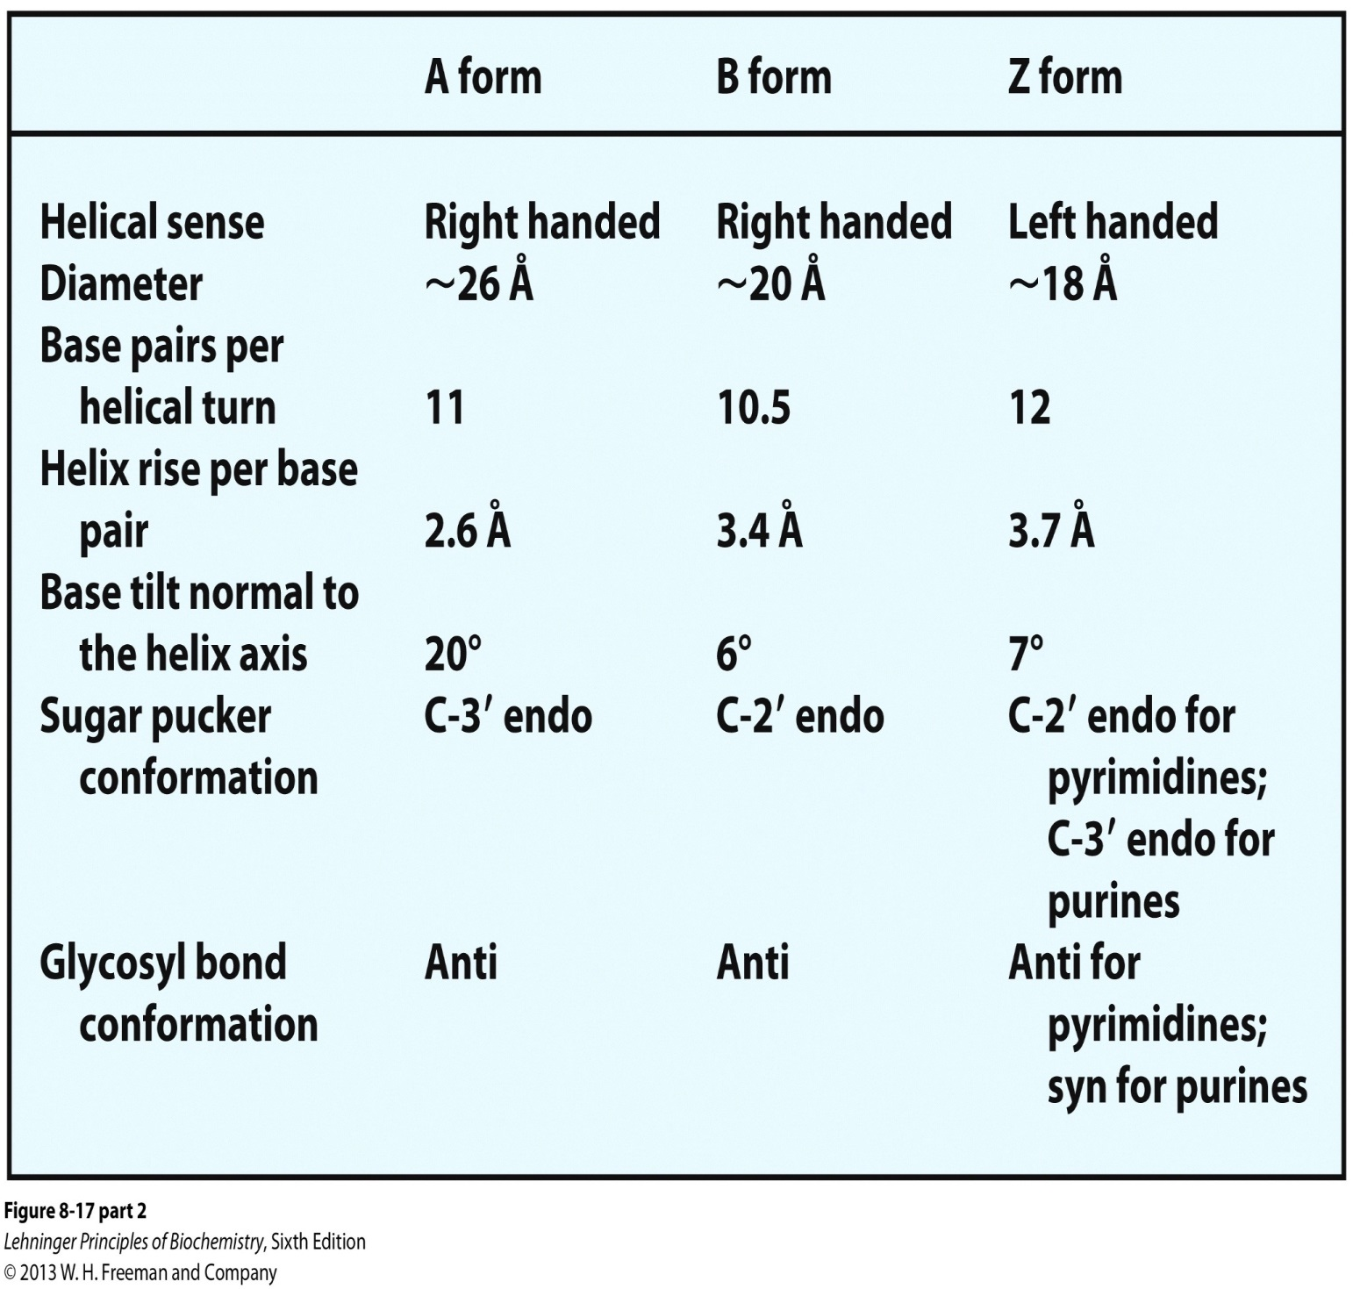
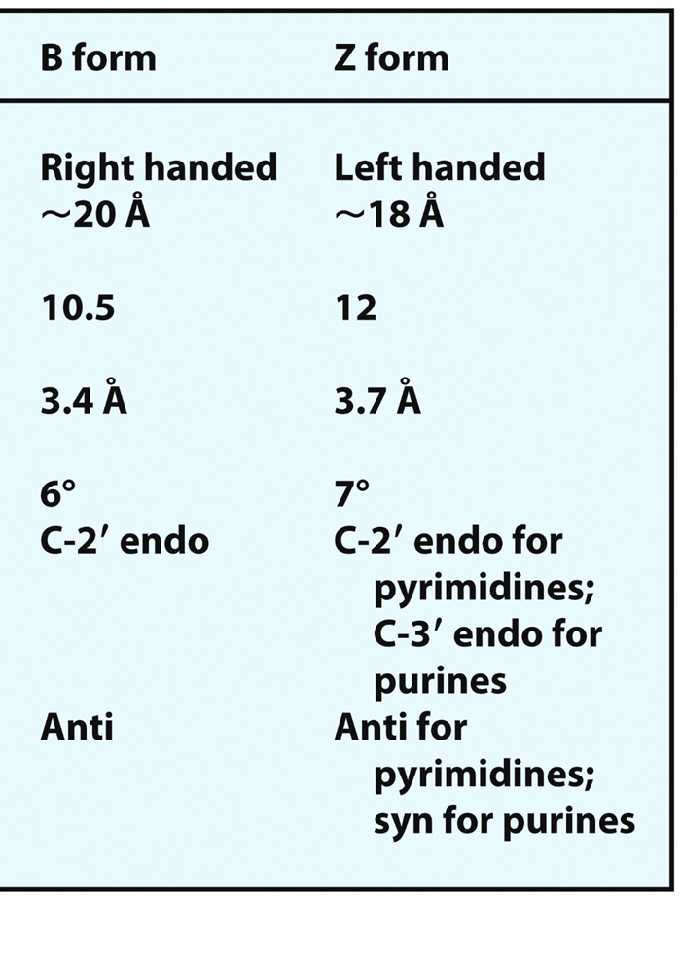
Watson-Crick Model of B-DNA
Notes:
LEGEND 8.13

Slide 20
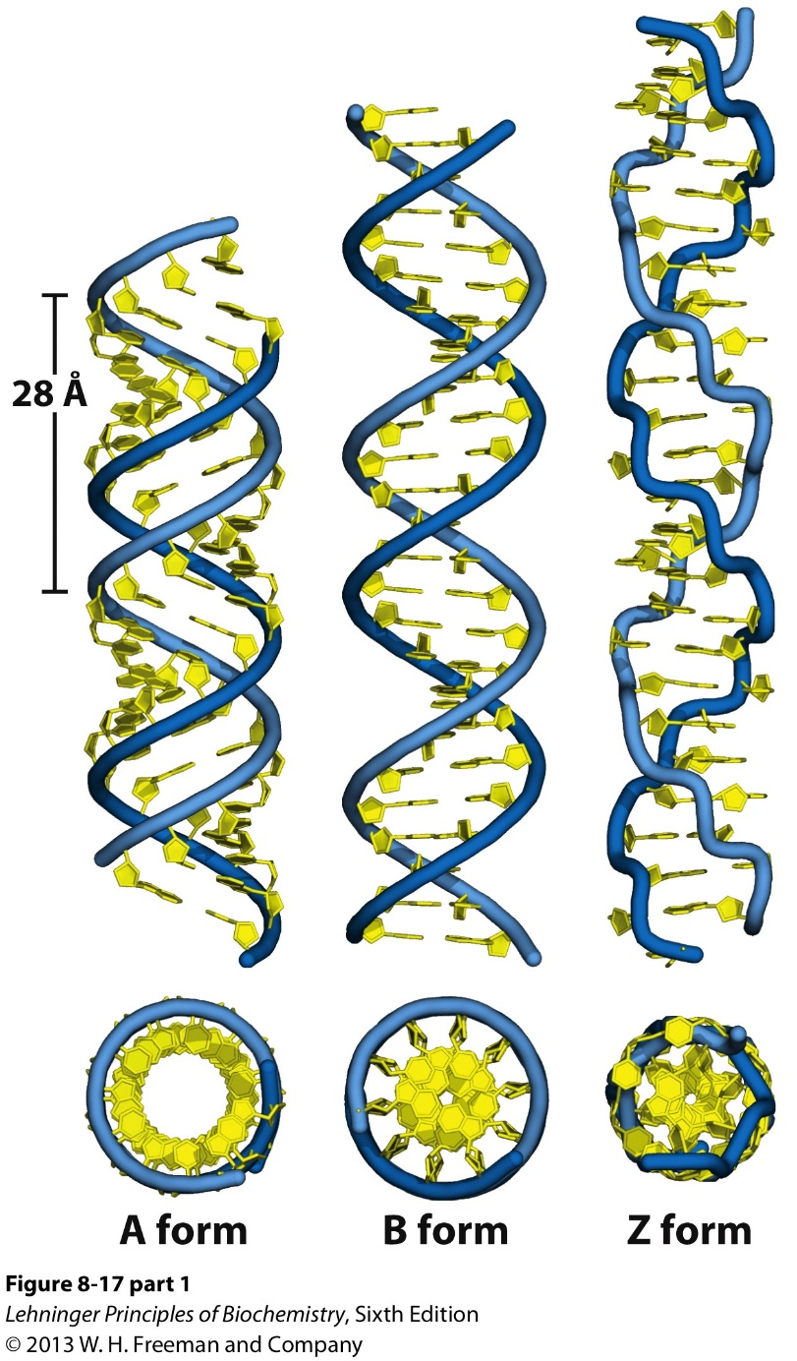
Other Forms of DNA
Notes:
LEGEND 8.17.1

Slide 21
Conclusions of Lecture-4
DNA Characteristics: double helix, right handed
Nucleotide vs nucleoside.
Nitrogenous bases: A, G, C, T, U
Pentose Sugar: 2’-deoxyribose and Ribose, endo and exo conformation
Phosphate: mono, di and triphosphate (AMP, ADP, ATP energy carriers)
β-N Glycosidic bond (Syn and Anti conformation)
Polymers of nucleotides = Polynucleotides (3’ OH attacks 5’ attached to α-phosphate )
One chain is complementary to other chain A-T ; G-C
Canonical bonds and Non-canonical pairing
Stability of DNA: Phosphodiester, electrostatic repulsion, Hydrogen bonds, Vander Waals; base stacking

Slide 22
Conclusions of Lecture-4
2nm distance
10.5 bases/turn; .34 nm rise per base
Major and Minor groove
Other forms of DNA: A and Z form

Slide 23
Types of Questions?
30 % of A is in dsDNA, find out the % of G?
The Nitrogenous base is linked to the ribose or deoxyribose sugar via a ____________.
Two experimental tubes contain an equal number of nucleic acid molecules with the sequence 5’ AGCAGG 3’. The first tube contains single-stranded DNA and the second tube contains RNA. Which tube contains the greater mass? Explain your answer.
What type of interaction occurs between stacked bases in the DNA double helix and helps to stabilize the helix?
RNA and DNA are chemically similar, yet RNA is much less stable than DNA. Explain why.

Slide 24
Types of Questions?
Triple-helical DNA structures can result from Hoogsteen (non Watson-Crick) interactions. These interactions are primarily:
A) covalent bonds involving deoxyribose.
B) covalent bonds involving the bases.
C) hydrogen bonds involving deoxyribose.
D) hydrogen bonds involving the bases.
E) hydrophobic interactions involving the bases.
For the helix in double-stranded B-form DNA, the majority of the stability can be attributed to:
A) base-pairing interactions via H-bonds.
B) interactions along the phosphate backbone.
C) base-stacking interactions via van-der-Waals interactions.
D) covalent bonds between adjacent bases in one strand.
E) ionic interactions with metal ions.

Slide 25
Thank You!

